Slide 1
Markov Models

Slide 2
Uncertainty and Time
Often, we want to reason about a sequence of observations where the state of the underlying system is changing
Speech recognition
Robot localization
User attention
Medical monitoring
Global climate
Need to introduce time into our models

Slide 3
Markov Models (aka Markov chain/process)
X₀
X₁
X₂
X₃
P(X₀)
P(X_{t} | X_{t-1})
Value of X at a given time is called the state
The transition model P(X_{t} | X_{t-1}) specifies how the state evolves over time
Stationarity assumption: transition probabilities are the same at all times
Markov assumption: “future is independent of the past given the present”
X_{t+1} is independent of X₀,…, X_{t-1} given X_{t}

Slide 4
Example: Random walk in one dimension
-4
-3
-2
-1
0
1
2
3
4
State: location on the unbounded integer line
Initial probability: starts at 0
Transition model: P(X_{t} = k| X_{t-1}= k±1) = 0.5
Applications: particle motion in crystals, stock prices, etc.

Slide 5
Example: n-gram models
State: word at position t in text (can also build letter n-grams)
Transition model (probabilities come from empirical frequencies):
Unigram (zero-order): P(Word_{t} = i)
“logical are as are confusion a may right tries agent goal the was . . .”
Bigram (first-order): P(Word_{t} = i | Word_{t-1}= j)
“systems are very similar computational approach would be represented . . .”
Trigram (second-order): P(Word_{t} = i | Word_{t-1}= j, Word_{t-2}= k)
“planning and scheduling are integrated the success of naive bayes model is . . .”
Applications: text classification, spam detection, author identification, language classification, speech recognition

Slide 6
Example: Web browsing
State: URL visited at step t
Transition model:
With probability p, choose an outgoing link at random
With probability (1-p), choose an arbitrary new page
Question: What is the stationary distribution over pages?
I.e., if the process runs forever, what fraction of time does it spend in any given page?
Application: Google page rank

Slide 7
Example: Weather
States {rain, sun}
Initial distribution P(X₀)
Transition model P(X_{t} | X_{t-1})
Two ways to represent Markov chains
P(X₀)
sun | rain
0.5 | 0.5
0.9
0.3
0.9
rain
sun
sun
sun
0.1
0.3
rain
rain
0.7
0.7
0.1
X_{t-1} | P(X_{t}|X_{t-1})
 | sun | rain
sun | 0.9 | 0.1
rain | 0.3 | 0.7

Slide 8
Weather prediction
X_{t-1} | P(X_{t}|X_{t-1})
 | sun | rain
sun | 0.9 | 0.1
rain | 0.3 | 0.7
Time 0: <0.5,0.5>
What is the weather like at time 1?
P(X₁) = ∑_{x0} P(X₁,X₀=x₀)
= ∑_{x0} P(X₀=x₀) P(X₁| X₀=x₀)
= 0.5<0.9,0.1> + 0.5<0.3,0.7> = <0.6,0.4>

Slide 9
Weather prediction, contd.
X_{t-1} | P(X_{t}|X_{t-1})
 | sun | rain
sun | 0.9 | 0.1
rain | 0.3 | 0.7
Time 1: <0.6,0.4>
What is the weather like at time 2?
P(X₂) = ∑_{x1} P(X₂,X₁=x₁)
= ∑_{x1} P(X₁=x₁) P(X₂| X₁=x₁)
= 0.6<0.9,0.1> + 0.4<0.3,0.7> = <0.66,0.34>

Slide 10
Weather prediction, contd.
X_{t-1} | P(X_{t}|X_{t-1})
 | sun | rain
sun | 0.9 | 0.1
rain | 0.3 | 0.7
Time 2: <0.66,0.34>
What is the weather like at time 3?
P(X₃) = ∑_{x2} P(X₃,X₂=x₂)
= ∑_{x2} P(X₂=x₂) P(X₃| X₂=x₂)
= 0.66<0.9,0.1> + 0.34<0.3,0.7> = <0.696,0.304>

Slide 11
Forward algorithm (simple form)
What is the state at time t?
P(X_{t}) = ∑_{xt-1} P(X_{t},X_{t-1}=x_{t-1})
= ∑_{xt-1} P(X_{t-1}=x_{t-1}) P(X_{t}| X_{t-1}=x_{t-1})
X₀
X₁
X₂
X₃
P(X₀)
P(X_{t} | X_{t-1})

Slide 12
Forward algorithm in Matrices
What is the weather like at time 2?
P(X₂) = 0.6<0.9,0.1> + 0.4<0.3,0.7> = <0.66,0.34>
In matrix-vector form:
P(X₂) = ( ) ( ) = ( )
X_{t-1} | P(X_{t}|X_{t-1})
 | sun | rain
sun | 0.9 | 0.1
rain | 0.3 | 0.7
0.9 0.3
0.1 0.7
0.6
0.4
0.66
0.34

Slide 13
Stationary Distributions
The limiting distribution is called the stationary distribution P∞ of the chain
It satisfies P∞ = P_{∞+1} = T^{T} P∞
Stationary distribution is <0.75,0.25> regardless of starting distribution
( ) ( ) = ( )
0.9 0.3
0.1 0.7
p
1-p
p
1-p

Slide 14
Hidden Markov Models

Slide 15
Hidden Markov Models
Usually the true state is not observed directly
Hidden Markov models (HMMs)
Underlying Markov chain over states X
You observe evidence E at each time step
X_{t} is a single discrete variable; E_{t} may be continuous and may consist of several variables
X₀
X₁
X₂
X₃
X₅
E₁
E₂
E₃
E₅

Slide 16
Example: Weather HMM
W_{t-1} | P(W_{t}|W_{t-1})
 | sun | rain
sun | 0.9 | 0.1
rain | 0.3 | 0.7
An HMM is defined by:
Initial distribution: P(X₀)
Transition model: P(X_{t}| X_{t-1})
Sensor model: P(E_{t}| X_{t})
Weather_{t-1}
Weather_{t}
Weather_{t+1}
W_{t} | P(U_{t}|W_{t})
 | true | false
sun | 0.2 | 0.8
rain | 0.9 | 0.1
Umbrella_{t-1}
Umbrella_{t}
Umbrella_{t+1}
Notes:
demo

Slide 17
HMM as probability model
Joint distribution for Markov model: P(X₀,…, X_{T}) = P(X₀) ∏_{t=1:T} P(X_{t} | X_{t-1})
Joint distribution for hidden Markov model: P(X₀,E₀,X₁,E₁,…, X_{T},E_{T}) = P(X₀) ∏_{t=1:T} P(X_{t} | X_{t-1}) P(E_{t} | X_{t})
Future states are independent of the past given the present
Current evidence is independent of everything else given the current state
Are evidence variables independent of each other?
X₀
X₁
X₂
X₃
X₅
E₁
E₂
E₃
E₅
Notes:
Add conditional independence consequences here

Slide 18
Real HMM Examples
Speech recognition HMMs:
Observations are acoustic signals (continuous valued)
States are specific positions in specific words (so, tens of thousands)
Machine translation HMMs:
Observations are words (tens of thousands)
States are translation options
Robot tracking:
Observations are range readings (continuous)
States are positions on a map (continuous)
Molecular biology:
Observations are nucleotides ACGT
States are coding/non-coding/start/stop/splice-site etc.

Slide 19
Conditional Independence in HMM
X₁
X₂
X₃
X₄
e₁
e₂
e₃
e₄
Base on D-separation algorithm (see the Bayesian Network slides). Since no two nodes have common children, to test whether A $⫫$ B | C, we only need to check whether C blocks every path from A to B
For example,
X_{j} $⫫$ X_{k} | X_{i}
X_{j} $⫫$ E_{k} | X_{i}
E_{j} $⫫$ X_{k} | X_{i}
E_{j} $⫫$ E_{k} | X_{i}
$$∀ j<i<k$$
$$∀ j<i≤k$$
$$∀ j≤i<k$$
$$∀ j≤i≤k, j≠k$$

Slide 20
Inference tasks
Useful notation:
X_{a:b} = X_{a} , X_{a+1}, …, X_{b}
Filtering: P(X_{t}|e_{1:t})
belief state—input to the decision process of a rational agent
Prediction: P(X_{t+k}|e_{1:t}) for k > 0
evaluation of possible action sequences; like filtering without the evidence
Smoothing: P(X_{k}|e_{1:t}) for 0 ≤ k < t
better estimate of past states, essential for learning
Most likely explanation: arg max_{x1:t} P(x_{1:t} | e_{1:t})
speech recognition, decoding with a noisy channel

Slide 21
Inference tasks
Filtering: P(X_{t}|e_{1:t})
Prediction: P(X_{t+k}|e_{1:t})
X₁
X₂
X₃
X₄
X₁
X₂
X₃
X₄
e₁
e₂
e₃
e₄
e₁
e₂
e₃
Smoothing: P(X_{k}|e_{1:t}), k<t
Explanation: P(X_{1:t}|e_{1:t})
X₁
X₂
X₃
X₄
X₁
X₂
X₃
X₄
e₁
e₂
e₃
e₄
e₁
e₂
e₃
e₄

Slide 22
Filtering / Monitoring
Filtering, or monitoring, or state estimation, is the task of maintaining the distribution P(X_{t}|e_{1:t}) over time
The Kalman filter (continuous variables, linear dynamics, Gaussian noise) was invented in 1960 and used for trajectory estimation in the Apollo program.
Notes:
Dan has some demo for this

Slide 23
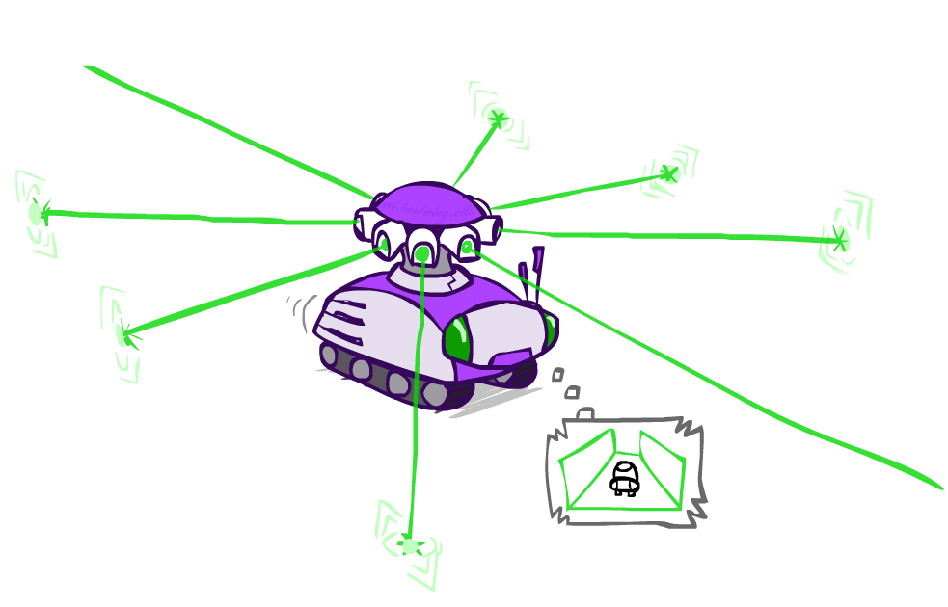
Example: Robot Localization
Example from Michael Pfeiffer
Prob
0
1
t=0
Sensor model: four bits for wall/no-wall in each direction, never more than 1 mistake
Transition model: action may fail with small prob.

Slide 24
Example: Robot Localization
Prob
0
1
t=1
Lighter grey: was possible to get the reading,
but less likely (required 1 mistake)

Slide 25
Example: Robot Localization
Prob
0
1
t=2

Slide 26
Example: Robot Localization
Prob
0
1
t=3

Slide 27
Example: Robot Localization
Prob
0
1
t=4

Slide 28
Example: Robot Localization
Prob
0
1
t=5

Slide 29
Exact Inference in HMM

Slide 30
Filtering
$$P(X_{1})$$
$$P\left(X_{t} \right| X_{t−1})$$
X₁
X₂
X₃
X₄
$$P\left(E_{t} \right| X_{t})$$
e₁
e₂
e₃
e₄
$$P\left(X_{t} \right| e_{1:t})=?$$
$$=\frac{P(X_{1}, e_{1})}{P(e_{1})}$$
Base case:
$$P\left(X_{1} \right| e_{1})$$
$$∝P\left(X_{1}, e_{1}\right)$$
$$=P\left(X_{1}\right)P(e_{1}|X_{1})$$
Passage of time:
Suppose we have $P\left(X_{t} \right| e_{1:t})$.
How to calculate $P\left(X_{t+1} \right| e_{1:t+1})$?
$P\left(X_{t} \right| e_{1:t})$
$P\left(X_{t+1}, X_{t} \right| e_{1:t})$
$P\left(X_{t+1}, {e_{t+1}, X}_{t} \right| e_{1:t})$
$P\left(X_{t+1}, e_{t+1} \right| e_{1:t})$
$P\left(X_{t+1}\right| e_{1:t+1})$
Joining $P\left(X_{t+1} \right| X_{t})$
Joining $P\left(e_{t+1} \right| X_{t+1})$
Marginalize out $X_{t}$
Normalize
$$P\left(X_{t+1} \right| e_{1:t+1})∝\sum_{x_{t}}{P\left(x_{t} \right| e_{1:t})P\left(X_{t+1} \right| x_{t}) P\left(e_{t+1} \right| X_{t+1})}$$
Time complexity?

Slide 31
Exercise
W₁
W₂
W₃
W₄
$$P\left(W_{2}\right| U_{1:2}=\left(T, F\right) )= ?$$
u₁
u₂
u₃
u₄
W_{t-1} | P(W_{t}|W_{t-1})
 | sun | rain
sun | 0.9 | 0.1
rain | 0.3 | 0.7
W_{t} | P(U_{t}|W_{t})
 | T | F
sun | 0.2 | 0.8
rain | 0.9 | 0.1

Slide 32
Prediction
X₁
X₂
X₃
X₄
X₅
X₆
X₇
$$P\left(X_{t+k} \right| e_{1:t})=?$$
e₁
e₂
e₃
e₄
E₅
E₆
E₇
We already have $P\left(X_{t} \right| e_{1:t})$ by filtering
$$P\left(X_{t+1} \right| e_{1:t})=\sum_{x_{t}}{P\left(x_{t} \right| e_{1:t})P\left(X_{t+1} \right| x_{t}) }$$
$$P\left(X_{t+2} \right| e_{1:t})=\sum_{x_{t+1}}{P\left(x_{t+1} \right| e_{1:t})P\left(X_{t+2} \right| x_{t+1}) }$$
…
$$P\left(X_{t+k} \right| e_{1:t})=\sum_{x_{t+k−1}}{P\left(x_{t+k} \right| e_{1:t})P\left(X_{t+k} \right| x_{t+k−1}) }$$

Slide 33
Smoothing
X₁
X₂
X₃
X₄
X₅
X₆
X₇
$P\left(X_{k} \right| e_{1:t})=?$ for some $k<t$
e₁
e₂
e₃
e₄
e₅
e₆
e₇
Here we introduce an approach slightly different from variable elimination.
$$P\left(X_{k} | e_{1:t}\right)$$
$$∝P\left(X_{k}, e_{k+1:t} \right| e_{1:k})$$
$$=P(X_{k} \left| e_{1:k}\right) P\left(e_{k+1:t} \right| X_{k})$$
Forward algorithm (filtering)
Backward algorithm
Just with one forward pass and one backward pass, we can calculate $P\left(X_{k} \right| e_{1:t})$ for all k.

Slide 35
Most-Likely Sequence
$$\underset{X_{1:t}}{argmax} P\left(X_{1:t} \right| e_{1:t})=?$$
Find the sequence that maximizes the probability (e.g., speech recognition, sequence decoding)
$$P\left(X_{1:t} \right| e_{1:t})∝P\left(X_{1:t}, e_{1:t}\right)=P\left(X_{1}\right)P(e_{1}|X_{1}) P\left(X_{2}\right|X_{1})P(e_{2}\left|X_{2}\right)⋯P\left(X_{t}\right|X_{t−1})P(e_{t}\left|X_{t}\right)$$
Time 1
Time 2
Time t
a
a
a
b
b
b
Possible states
…
…
…
z
z
z
Find a sequence, e.g. $X_{1}=b, { X}_{2}=a, …, X_{t}=z$ that maximize $P\left(X_{1:t}, e_{1:t}\right)$

Slide 36
Most-Likely Sequence through Dynamic Programming
$$P\left(X_{1:t} \right| e_{1:t})∝P\left(X_{1:t}, e_{1:t}\right)=P\left(X_{1}\right)P(e_{1}|X_{1}) P\left(X_{2}\right|X_{1})P(e_{2}\left|X_{2}\right)⋯P\left(X_{t}\right|X_{t−1})P(e_{t}\left|X_{t}\right)$$
Time 1
Time 2
Time t
a
a
a
b
b
b
Possible states
…
…
…
z
z
z
Viterbi Algorithm
For each state s, let $Prob\left[1\right]\left[s\right]=P\left(X_{1}=s\right) P(e_{1}|X_{1}=s)$
For $k=2, …, t:$
For each states s, let $Prob\left[k\right]\left[s\right]=\max_{s^{′}} Prob\left[k−1\right]\left[s^{′}\right]×P\left(X_{k}=s \right| X_{k−1}=s′)×P(e_{k}|X_{k}=s)$

Slide 37
Approximate Inference in HMM

Slide 38
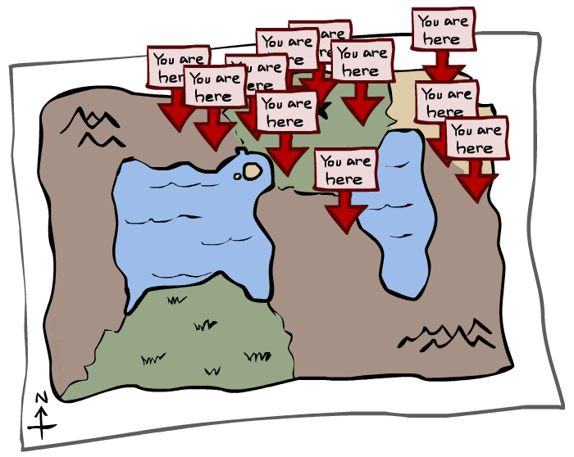
Particle Filtering

Slide 39
Particle Filtering
Filtering: approximate solution
Sometimes |X| is too big to use exact inference
|X| may be too big to even store P(X)
E.g. X is continuous
Solution: approximate inference
Track samples of X, not all values
Samples are called particles
Time per step is linear in the number of samples
But: number needed may be large
In memory: list of particles, not states
This is how robot localization works in practice
Particle is just new name for sample
0.0
0.1
0.0
0.0
0.0
0.2
0.0
0.2
0.5

Slide 40
Representation: Particles
Our representation of P(X) is now a list of N particles (samples)
Generally, N << |X|
Storing map from X to counts would defeat the point
P(x) approximated by number of particles with value x
So, many x may have P(x) = 0
More particles, more accuracy
For now, all particles have a weight of 1
Particles:
(3,3)
(2,3)
(3,3)
(3,2)
(3,3)
(3,2)
(1,2)
(3,3)
(3,3)
(2,3)

Slide 41
Particle Filtering: Elapse Time
Each particle is moved by sampling its next position from the transition model
This is like prior sampling – samples’ frequencies reflect the transition probabilities
This captures the passage of time
If enough samples, close to exact values before and after (consistent)
Particles:
(3,3)
(2,3)
(3,3)
(3,2)
(3,3)
(3,2)
(1,2)
(3,3)
(3,3)
(2,3)
Particles:
(3,2)
(2,3)
(3,2)
(3,1)
(3,3)
(3,2)
(1,3)
(2,3)
(3,2)
(2,2)

Slide 42
Particle Filtering: Observe
Don’t sample observation, fix it
Similar to likelihood weighting, downweight samples based on the evidence
As before, the probabilities don’t sum to one, since all have been downweighted
Particles:
(3,2)
(2,3)
(3,2)
(3,1)
(3,3)
(3,2)
(1,3)
(2,3)
(3,2)
(2,2)
Particles:
(3,2) w=.9
(2,3) w=.2
(3,2) w=.9
(3,1) w=.4
(3,3) w=.4
(3,2) w=.9
(1,3) w=.1
(2,3) w=.2
(3,2) w=.9
(2,2) w=.4

Slide 43
Particle Filtering: Resample
Rather than tracking weighted samples, we resample
N times, we choose from our weighted sample distribution (i.e. draw with replacement)
This is similar to renormalizing the distribution
Now the update is complete for this time step, continue with the next one
Particles:
(3,2) w=.9
(2,3) w=.2
(3,2) w=.9
(3,1) w=.4
(3,3) w=.4
(3,2) w=.9
(1,3) w=.1
(2,3) w=.2
(3,2) w=.9
(2,2) w=.4
(New) Particles:
(3,2)
(2,2)
(3,2)
(2,3)
(3,3)
(3,2)
(1,3)
(2,3)
(3,2)
(3,2)

Slide 44
Recap: Particle Filtering
Particles: track samples of states rather than an explicit distribution
Elapse
Weight
Resample
Particles:
(3,3)
(2,3)
(3,3)
(3,2)
(3,3)
(3,2)
(1,2)
(3,3)
(3,3)
(2,3)
Particles:
(3,2)
(2,3)
(3,2)
(3,1)
(3,3)
(3,2)
(1,3)
(2,3)
(3,2)
(2,2)
Particles:
(3,2) w=.9
(2,3) w=.2
(3,2) w=.9
(3,1) w=.4
(3,3) w=.4
(3,2) w=.9
(1,3) w=.1
(2,3) w=.2
(3,2) w=.9
(2,2) w=.4
(New) Particles:
(3,2)
(2,2)
(3,2)
(2,3)
(3,3)
(3,2)
(1,3)
(2,3)
(3,2)
(3,2)

Slide 45
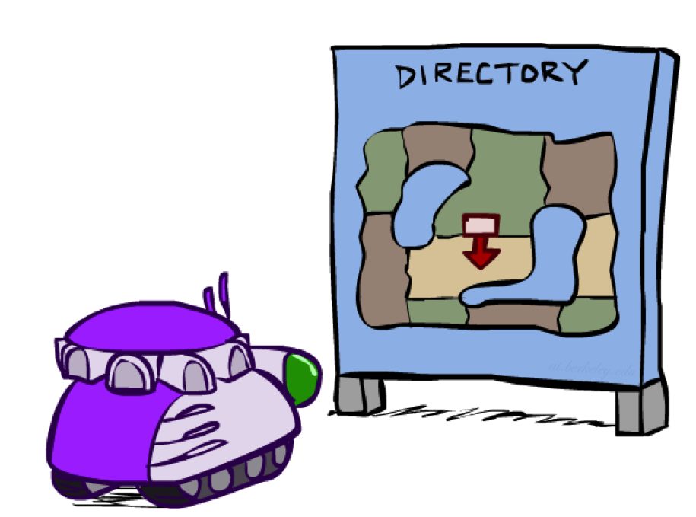
Robot Localization
In robot localization:
We know the map, but not the robot’s position
Observations may be vectors of range finder readings
State space and readings are typically continuous (works basically like a very fine grid) and so we cannot store B(X)
Particle filtering is a main technique
X₁
X₂
X₃
X₄
True location
e₁
e₂
e₃
e₄
Sensor signal

Slide 46
Particle Filter Localization (Sonar)

Slide 47
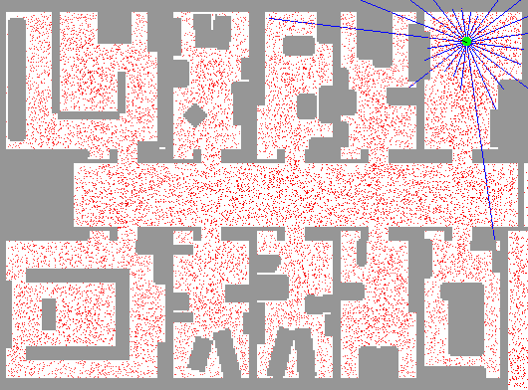
Particle Filter Localization (Laser)

Slide 48
Robot Mapping
SLAM: Simultaneous Localization And Mapping
We do not know the map or our location
State consists of position AND map!
Main techniques: Kalman filtering (Gaussian HMMs) and particle methods

Slide 49
Particle Filter SLAM – Video 1

Slide 50
Particle Filter SLAM – Video 2

Slide 51
Particle Filtering
Localization: https://www.youtube.com/watch?v=NrzmH_yerBU&ab_channel=MATLAB
SLAM: https://www.youtube.com/watch?v=saVZtgPyyJQ&ab_channel=MATLAB

Slide 52
Some Failure Modes of Particle Filtering
Too few particles
 |  |  | ●
 |  |  |  |  |  | $$×$$
● Particle
$×$ True location
→ The particle has to be dense enough to cover the true state

Slide 53
Some Failure Modes of Particle Filtering
Moderate number of particles but very static state transition
 |  |  |  |  |  |  | ●
 |  |  |  | ●
 |  |  | ● |  |  |  |  | ●
 |  |  |  | ● |  |  |  | ●
 |  |  |  |  |  | $$×$$
 |  |  |  |  | ●
● Particle
$×$ True location
Suppose every state always transitions to itself.
All particles and the true location will never move.
After several rounds of re-sampling, particles will accumulate to a single position.

Slide 54
Homework 4

Slide 55
Homework 4
1. Choice Questions (10 points)
10 questions.
Answer directly on Gradescope
The same requirements as the last time.
2. Program Questions (25 points)
Ghostbusters and Bayes Nets

Slide 56
Introduction of Project 4: Ghostbusters and Bayes Nets
Color Blocks:
Indicate possible locations of each ghost based on distance readings.
Primary Task:
Implement inference to track ghost positions.
Improve on the default crude inference (shaded areas show possible ghost locations).
Use Bayes Nets for exact and approximate inference.

Slide 57
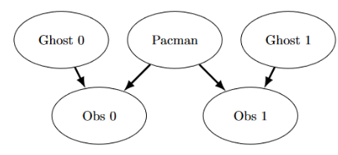
Question 1 (2 points): Bayes Net Structure
Objective:
Implement constructBayesNet function in inference.py to create an empty Bayes Net structure as described.
Tasks:
Add variables and edges based on the diagram.
Pacman and the two ghosts can be anywhere in the grid
Observations here are non-negative, equal to Manhattan distances of Pacman to ghosts ± noise.

Slide 58
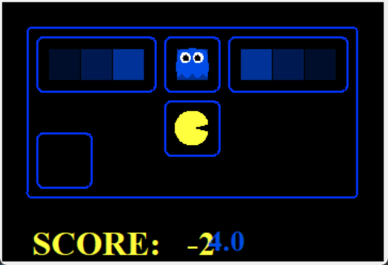
Question 2: Join Factors
Objective:
Takes a list of Factors and returns a new Factor.
The new Factor's entries are the product of corresponding rows of input Factors.
Assumptions:
joinFactors may operate on factors without probability tables (rows may not sum to 1).
Examples:

Slide 59
Question 3: Eliminate (not ghosts yet)
Objective:
Takes a Factor and a variable to eliminate.
Returns a new Factor without that variable, by summing entries differing in the eliminated variable’s value.

Slide 60
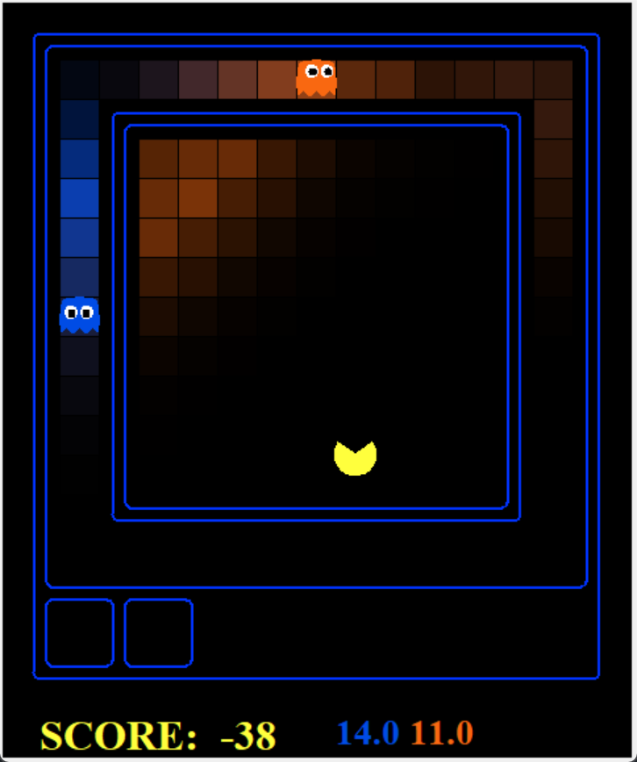
Question 4: Variable Elimination
Objective: Answers a probabilistic query represented using, A BayesNet, A list of query variables and Evidence.
Hints and Observations:
Refer to inferenceByEnumeration function for guidance.
Sum of probabilities should equal 1 (to ensure it’s a true conditional probability).
Enumeration joins all variables first and then eliminates all hidden variables.
Variable Elimination interleaves join and eliminate, processing one hidden variable at a time.
Handle cases where a factor has only one unconditioned variable after joining.

Slide 61
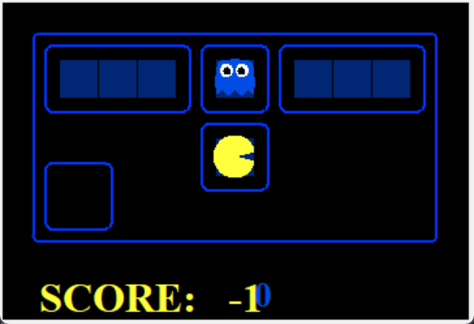
Question 5a and 5b
5a objective:
Complete DiscreteDistribution to extends the Python dictionary, where keys are elements of the distribution, and values are the associated weights.
5b objective:
Complete getObservationProb to Calculates the probability of a noisy distance reading between Pacman and a ghost.

Slide 62
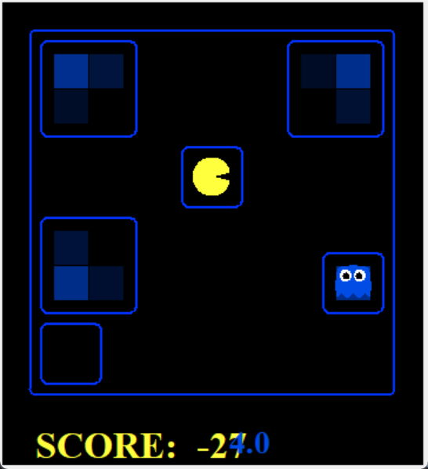
Question 6: Exact Inference Observation
Objective:
Implement observeUpdate to update the belief distribution over ghost positions based on Pacman’s sensor observations.
Display Behavior:
High posterior beliefs are shown as bright colors; low beliefs are dim.
Beliefs should start broad and narrow down as more evidence is collected.

Slide 63
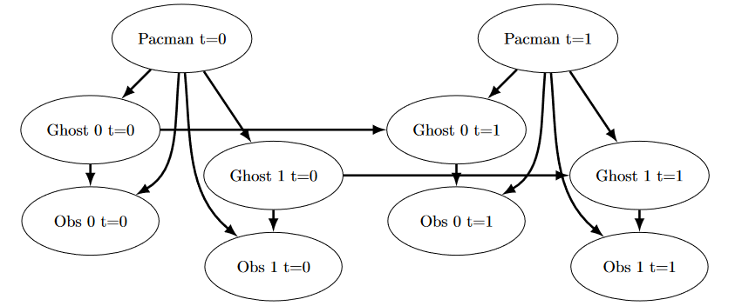
Question 7: Exact Inference with Time Elapse
Objective:
Implement the elapseTime to update ghost position beliefs over time based on movement patterns without observing them.

Slide 64
Question 7: Exact Inference with Time Elapse
Notes:
If code is slow, reduce calls to self.getPositionDistribution.
Pacman’s belief distribution adjusts based on possible ghost movements without direct observation.
Beliefs will adapt to the board geometry and likely ghost moves over time.
Special Ghost Behavior:
GoSouthGhost: A ghost that tends to move south over time.
Pacman’s belief distribution should focus near the board’s bottom as the GoSouthGhost moves south.

Slide 65
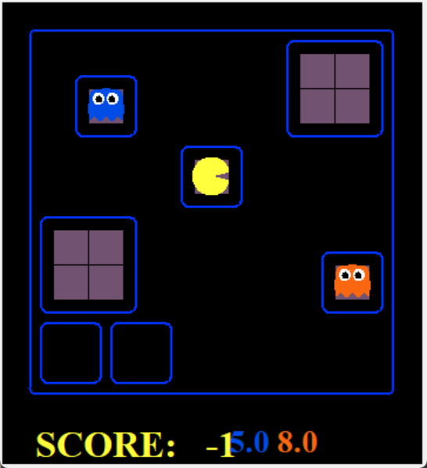
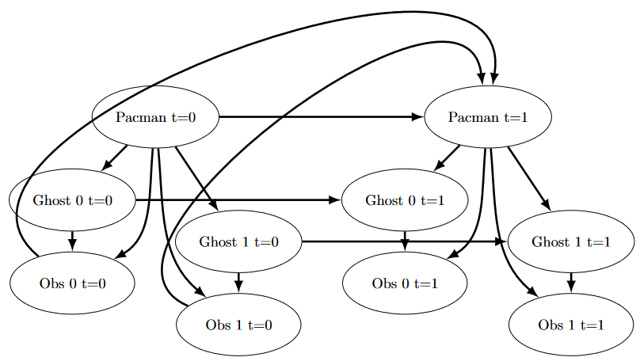
Question 8: Exact Inference Full Test
Objective:
The agent should select actions based on the belief distribution to move towards the closest ghost.
Tasks:
Identify the most likely position of each uncaptured ghost.
Choose an action that minimizes the maze distance to the closest ghost.

Slide 66
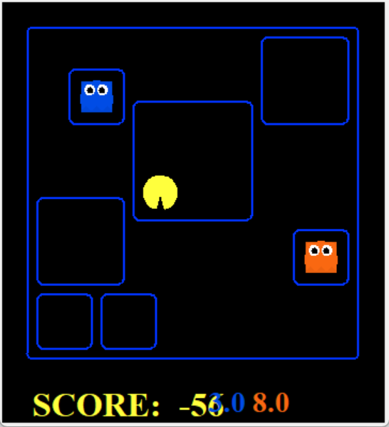
Question 9: Approximate Inference Initialization & Beliefs
Objective:
Implement initializeUniformly and getBeliefDistribution to set up a particle filtering algorithm to track a single ghost.
Method Details:
initializeUniformly:
Distribute particles evenly across all legal ghost positions (ensures a uniform prior).
Consider using the mod operator to achieve even distribution.
getBeliefDistribution:
Convert the list of particles into a DiscreteDistribution object representing the belief distribution.

Slide 67
Question 10 & 11: Approximate Inference Observation
Q10: Approximate Inference Observation
Implement the observeUpdate for updating the weight distribution over self.particles based on Pacman’s observation.
Q11: Approximate Inference with Time Elapse
Implement the elapseTime to update self.particles by constructing a new list of particles that corresponds to each existing particle advancing a time step.

